Slide 1
Data Types
MongoDataTypes_Bipin

Slide 2
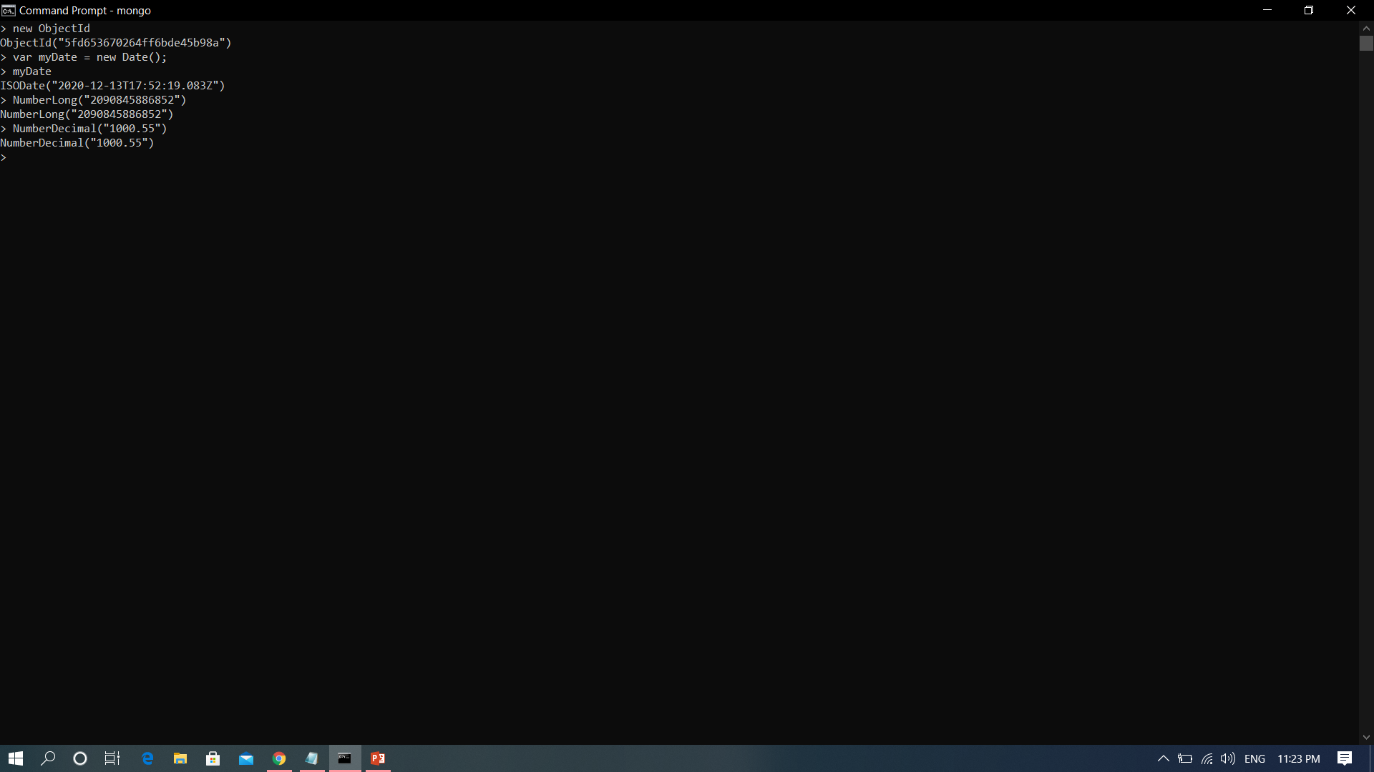
ObjectId, Date, NumberLong, NumberDecimal

Slide 3
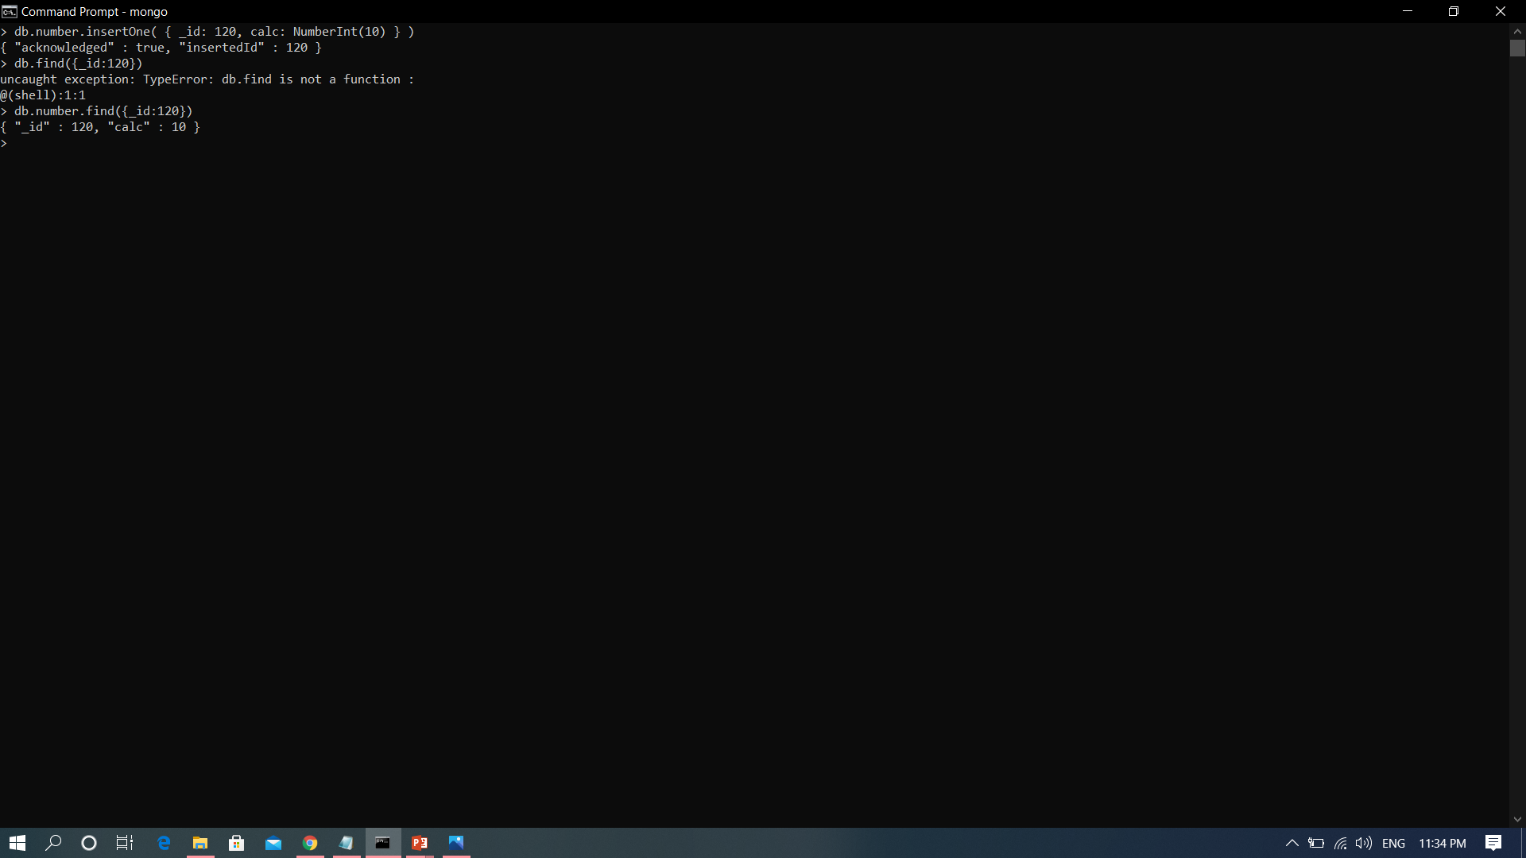
NumberInt

Slide 4
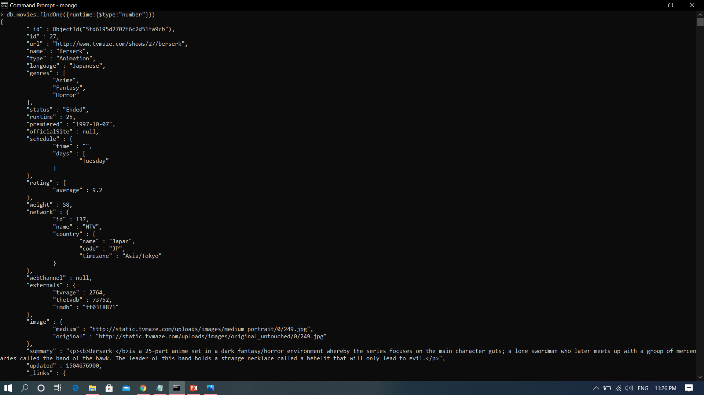
Number

Slide 5
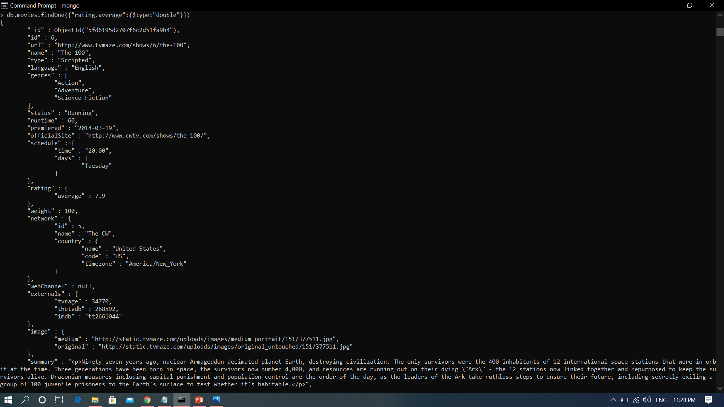
double

Slide 6
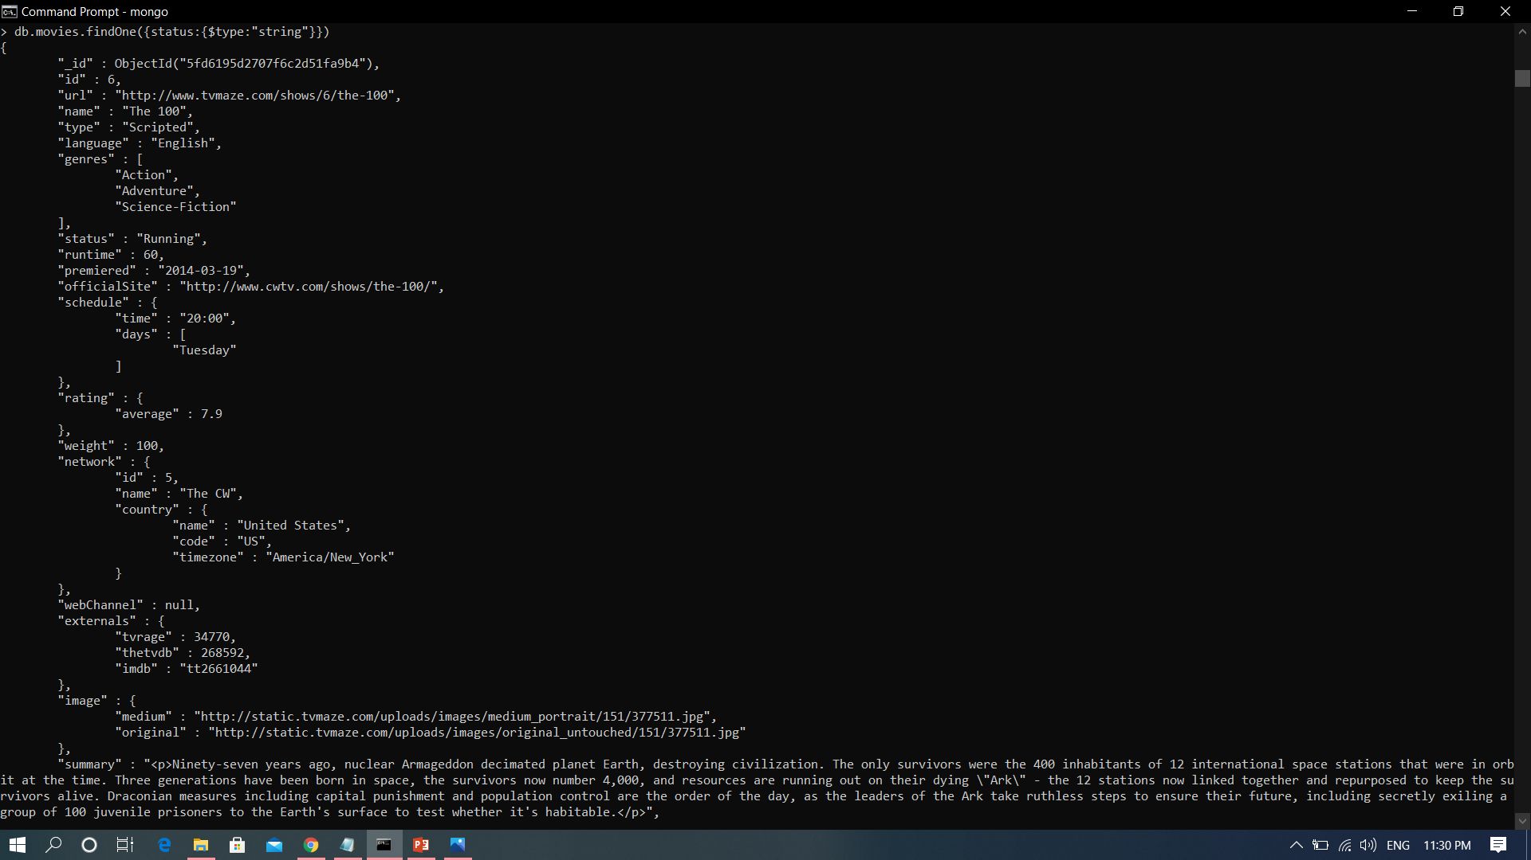
string

Slide 7

array

Slide 8
Integer
db.TestCollection.insert({"Integer example": 62})
Boolean
db.TestCollection.insert({"Nationality Indian": true})
Double
db.TestCollection.insert({"double data type": 3.1415})
String
db.TestCollection.insert({"string data type" : "This is a sample message."})
Array
var degrees = ["BCA", "BS", "MCA"]
db.TestCollection.insert({" Array Example" : " Here is an example of array", " Qualification" : degrees})
Object
var embeddedObject={"English" : 94, "ComputerSc." : 96, "Maths" : 80,"GeneralSc." : 85}
db.TestCollection.insert({"Object data type" : "This is Object", "Marks" : embeddedObject})
Null
db.TestCollection.insert({" EmailID ": null})

